Slide 1
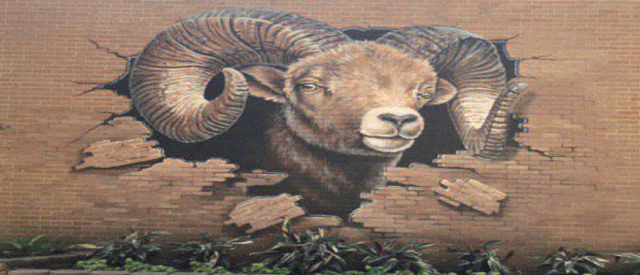
T. H. Rogers 2022 – 2023 Vanguard Program
Principal:
Tiffany Chenier
Assistant Principals:
Rania Khalil
Scott Platt
Gregory Wagner
Dean of Instruction:
Jessica Willie Beaulieu
Magnet Coordinator:
Barbra Hearne
Counselor:
Bradley Evans
Teacher Specialist
Steven Ghorbanian
“Where Academics and
Character Matter”

Slide 2
What to Expect:
PowerPoint Presentation
Q & A
3. School Tour (breakout into 2 groups Elementary and Middle School)

Slide 3
Magnet vs. Vanguard Magnet
Magnet Schools – specializes in a particular theme (fine arts, health sciences, STEM, Vanguard, etc.).
Vanguard Magnet School – specializes in Gifted and Talented (GT) identified students with accelerated instruction.

Slide 4
TX Education Code 89.3
Requires all public schools in Texas to provide services to GT identified students.

Slide 5
In HISD
Services are handled one of four ways:
1. Pull-outs (usually elementary)
2. Blended classes (has both GT and non -GT students)
3. Homogeneous classes (all GT)
4. HISD Advanced (Formerly Pre-AP / IB or AP middle
and high school)

Slide 6
What about THR?
We are a Vanguard Magnet with NO zoned students.
All Middle School core classes (math, science, English, and social studies) are homogeneous and HISD Advanced (formerly labeled Pre-AP level).

Slide 7
How do I get in?
In order to attend THR’s Vanguard Program:
The student must apply to the program.
The student must qualify as GT.
The student must be selected in the HISD Magnet Lottery.

Slide 8
Why choose THR?

Slide 9
Elementary Curriculum:
Departmentalized K through 5th Grades (teachers teach to their passion)
Four teachers per grade level with a two-way team teach; students rotate between the two classes:
English Language Arts/Reading/Social Studies
Math/ Science
(opportunities for students to experience
varied learning styles)

Slide 10
Elementary Homework
You should expect 15 to 75 minutes
… every night …

Slide 11
Middle School Curriculum
All Core Classes are HISD Advanced (formerly called Pre-AP)
High School Credit (Algebra, Art, Geometry, Fundamentals of Computer Science, Integrated Physics & Chemistry, Foreign Language, etc.) (not automatic must audition or test into)
Traditional Block Schedule. Alternate between A & B Days

Slide 12
Middle School Homework
You should expect 1 to 3 hours
… every night …

Slide 13
Is it all work?
Elementary:
Art
Chess
Computer
STEM
Music
Orchestra
P.E.
Name That Book
Spelling Bee
Jr. Student Council
Middle School:
Name That Book
Chess
Drama & Speech
Math Counts/ Math Club
Orchestra
Scholastic Writing
Quiz Bowl
Student Council (StuCo)
National Juniors Honor Society (NJHS)
Sports: (Baseball, Volleyball, Swim, Track, Cross Country, and Basketball)

Slide 14
What Makes THR different?
All students in our program are labeled GT, all teachers are GT certified!
Our Vanguard program is intensely focused on Academics!

Slide 15
What else?
530 VG Elementary Students
450 VG Middle School Students
We Do Not have a school uniform
Very active PTO

Slide 16
Elementary Space Available:
88 Spaces for Kindergarten
0 Spaces for 1st, 2nd, 3rd, and 4th grades (based purely on attrition)
12 Spaces for 5th grade (currently 88 in 4th we add 12 more to make it 100 in 5th).

Slide 17
But if there are no spaces …
Why do you accept applications?
Because someone could leave
(Occasionally, students move over the summer)

Slide 18
Middle School Space Available:
50-60 Spaces for 6th Grade
10-15 Spaces for 7th
10-15 spaces for 8th grade

Slide 19
Let’s Go Over Testing …

Slide 20
Testing Information
Deadline for Vanguard Magnet 1st – 12th grade applicants to request G/T testing:
February 3, 2023
Deadline for Entering Kinder:
February 2, 2023
(Test dates for Entering Kinder will be a part of the online application system. Offered on Saturdays at Young Women’s College Prep Academy 1/14, 1/28, 2/11 and 2/25).
NOTE: Vanguard Magnet applicants that are not G/T-identified in HISD must request G/T testing at either: 1. The HISD school where he/she is enrolled, or, if not enrolled in HISD, 2. The HISD school where he/she is zoned to attend.

Slide 22
What about Documents?
Entering Kindergarten:
parent recommendation (which is part of the online application)
birth certificate
HISD:
teacher recommendation
report card 1st grade and up
Non-HISD:
report card
teacher recommendation for ALL grades.
If you have additional questions about documents,
email your highest ranked Vanguard school

Slide 23
PoR Warning
You must currently live within the boundaries of the Houston Independent School District when you apply to T. H. Rogers or your application will not be processed.

Slide 24
The Importance of Ranks
Your child will have an equal chance in all school lotteries to which you apply, and to which they have qualified to attend. You can choose up to 10 schools.
Ranks are important *AFTER* the lotteries have been run.
Schools are ranked by the order you list them.

Slide 25
Ranks and the Lottery:
Rank | Programs Applied To: | Lottery Outcome: | What Parents See:
Rank 1 | School A | Wait Listed | Wait Listed #
Rank 2 | School B | Wait Listed | Wait Listed #
Rank 3 | School C | Accepted | Accepted
Rank 4 | School D | Accepted | ** Dropped **
Rank 5 | School E | Accepted | ** Dropped **

Slide 26
What the Parent will See:
Rank | Programs Applied To: | What Parents See:
Rank 1 | School A | Wait List #
Rank 2 | School B | Wait List #
Rank 3 | School C | Accepted

Slide 27
Your Choice :
Rank | Programs Applied To: | What Parents See:
Rank 1 | School A | Wait List #
Rank 2 | School B | Wait List #
Rank 3 | School C | Accepted
Accept the seat at School C.
Decline the seat at School C.
You will no longer have accept offers from multiple schools.

Slide 28
To Be Clear …
The order of the ranks are the order in which you apply to schools. (First application is Rank 1, second application is Rank 2, and so on).

Slide 29
To be Absolutely Clear …
The system defaults to the highest ranked school to which your child both qualified and was accepted.
Be *VERY SURE* you have your schools ranked how you want them by the deadline.

Slide 30
Does My Child Need Testing?
If your student is going into Kindergarten – yes!
If your student is not currently labeled GT – yes!
If your student was labeled GT but left HISD (depends on how long you have been gone) – yes!

Slide 31
Important Lottery Info:
The online system runs each magnet school lottery separately.
What happens in one lottery has absolutely nothing to do with any other school’s lottery.
Sibling preference is given in Kinder and 6th Grades only!

Slide 32
Reminders:
The ranks will default to the highest accept.
You will never see what happened in the lottery for lower ranked schools that have dropped off your list.

Slide 33
What are the odds?
We truly have no idea!
Every year, “the odds” depends on a few things: How many applicants total? How many qualified as GT? How many spaces we have available for that grade level?

Slide 34
Remember:
In order to attend T. H. Rogers:
You must apply to T. H. Rogers.
Your student must be qualified as GT.
Your student must be selected in THR’s lottery.

Slide 35
Our one guarantee:
If you do not apply, you will not get into THR!

Slide 36
The Application Open: December 14, 2022 Close: February 2, 2023

Slide 37
School of Choice
Landing page for applications: https://choosehisd.my.site.com
Phone:
713.556.6947

Slide 38
Application
Complete one online application, add schools you want to apply to, rank them in order of importance to you.
Desktop and Mobil platforms are identical.

Slide 39
Time
Application approximately 20 minutes.
Do not forget to hit the submit button!!
If you go back in at a later date and make changes to your application be sure and go to last page and resubmit to capture changes.

Slide 40
Honestly …
You should apply to more than one school.

Slide 41
Be Strategic!
You can mix-and-match applications between Vanguard and non-Vanguard Magnets.
You can apply to a maximum of 10 schools, regardless of type of magnet.
If you do not know if your child is GT, you may want to be strategic in your applications.

Slide 42
The Dashboard
The Dashboard is where coordinators will leave messages to you regarding your application. Any message also triggers an email, so pick an email you check often!!!

Slide 43
Hot Spots:
Transportation!
Bilingual / ESL (LEP) – this is asking if your student is labeled 504. If you say yes, you have to provide documentation!
If your student is new to HISD they are more than likely NOT labeled!

Slide 44
Hot Spots:
Sharing a Lottery Number: it only applies to twins / triplets / quads / etc.
Please Note: you should only click this if you have twins / triplets / quads / etc. applying and you want them to share a lottery number. (creating multiple applications can backfire).

Slide 45
Deadlines
APPLICATIONS: | OPEN: December 14, 2022 CLOSE: February 2, 2023
DOCUMENTS: | ASAP!
LOTTERY: | Week of April 5, 2023

Slide 46
Q&A…
1. Call our Vanguard office: 713.917.3570.
2. Email: Ms. Hearne at: bhearne@houstonisd.org,
Ms. Hardy at:
LHARDY1@houstonisd.org, or
Ms. Buirse at:
Asia.Buirse@houstonisd.org.

Slide 47
Thank you for your time and consideration!
From the students, faculty, and staff of T. H. Rogers!

